Slide 1



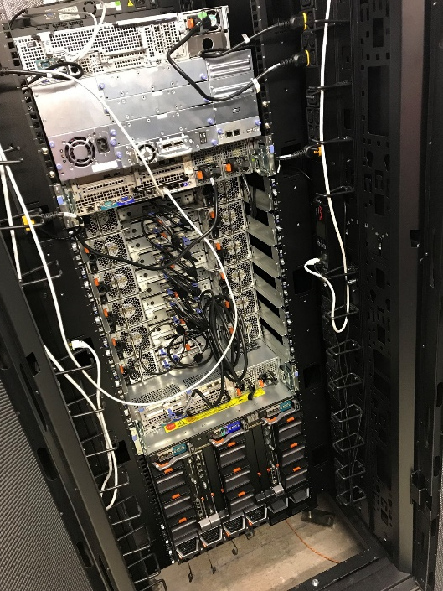




Teaching with JupyterHub - lessons learned
Prof. Martin Christen FHNW – University of Applied Sciences and Arts Northwestern Switzerland School of Architecture, Civil Engineering and Geomatics Institute Geomatics
martin.christen@fhnw.ch
MartinChristen GitHub: MartinChristen
GitLab: martin.christen
Notes:
Teaching with JupyterHub - lessons learned
JupyterHub allows creating a multi-user Hub which spawns multiple instances of the Jupyter notebook server. At the Institute Geomatics of the University of Applied Sciences and Arts Northwestern Switzerland JupyterHub is used for teaching Python in the master's course "GeoProcessing". The course uses large-scale (multi-terabyte) geodata and local instances of the Jupyter Notebook are no option. This talk shares experiences in setting up JupyterHub and it is shown how notebooks and exercises are shared with the class. The Institute of Geomatics also uses JupyterHub for research projects, especially involving deep learning or other tasks where GPUs and a high performance compute clusters are required. It will be shown how we currently set this up and how we plan to do it in near future.

Slide 2
https://github.com/martinchristen/EuroSciPy-2018-JupyterHub
https://github.com/jupyterhub

Slide 3
What am I teaching ? (Python related courses only)
Bachelor Programme Introduction to Python (1st Semester) Programming I (2nd Semester) Programming II (3rd Semester) Open (Geo-)Data Seminar (5th Semester)
Masters Programme Geoprocessing (14 Lessons)

Slide 4
Where? Our New Campus (4500 People, 250M €, built in 4 years)

Slide 5
What am I teaching ? (Python related courses only)
Bachelor Programme Introduction to Python (1st Semester) Programming I (2nd Semester) Programming II (3rd Semester) Open (Geo-)Data Seminar (5th Semester)
Masters Programme Geoprocessing (14 Lessons)
This course is about processing big geo data
Aerial images/Satellite images are large! (Petabyte range)
Problem #1 How can students store multiple 1-10 TB datasets?
Problem #2
Installing all required modules takes forever
Notes:
Other Problems:
Some Students don’t want to waste space on their laptop for anaconda/modules/(data)
I have to write installation instructions for each OS / Python Version and there are still problems
Most students don’t have a good graphics card (GPU)

Slide 6

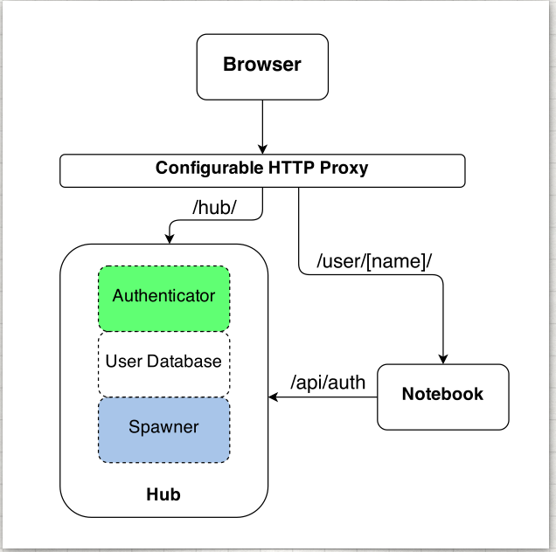
About JupyterHub
Jupyterhub: Jupyter for multiple users
The Hub launches a proxy
The proxy forwards all requests to the Hub by default
The Hub handles user login and spawns single-user servers on demand
The Hub configures the proxy to forward URL prefixes to the single-user notebook servers
Image from https://jupyterhub.readthedocs.io

Slide 7
Authenticators – User Login
Local User
OAuthenticator: GitHub/BitBucket/MediaWiki/CILogon/Google OAuth/…
Dummy Authenticator (For testing only! Not for production use.)
LDAP Authenticator
Kerberos Authenticator
REMOTE_USER Authenticator (For when intermediate login infrastructure such as Apache offloads authentication and forwards REMOTE_USER header.)
JSONWebToken Authenticator (For Authenticating/Authorising users based on a JSONWebToken forwarded in an Authorization: bearer <token> header.)
HashAuthenticator (Each user comes with a predefined password which is a hash of their username. A separate authenticator may be used for admins.)
CASAuthenticator for CAS Single Sign-on SSO

Slide 8
Spawners
BatchSpawner for spawning remote servers using batch systems (Torque, PBS, Slurm, etc)
DockerSpawner, which actually has two different spawners in it:
dockerspawner.DockerSpawner, for spawning identical Docker containers for each user
dockerspawner.SystemUserSpawner, for spawning Docker containers with an environment and home directory for each user
ImageSpawner for allowing users to choose which Docker image to spawn.
KubeSpawner for use with Kubernetes.
MarathonSpawner for spawning instances on Marathon.
UCRSpawner for spawning GPU instances on Marathon.
RemoteSpawner
SimpleSpawner, for testing purposes.
SystemdSpawner, spawns notebooks with the isolation / security benefits of containers without the complexity of image management.
SudoSpawner uses sudo. SystemdSpawner is recommended instead of SudoSpawner, if it is available to you.
WrapSpawner allows spawner class and options to be chosen at runtime. Includes ProfilesSpawner for doing this from a spawner options form. Formerly part of BatchSpawner.

Slide 9
Installation
Installation is easy if you read the docs:
https://jupyterhub.readthedocs.io/en/stable/installation-guide.html
You need Linux
You can use Docker
You can install Jupyterhub without Docker
Cluster? GPU?
https://zero-to-jupyterhub-with-kubernetes.readthedocs.io/en/latest/index.html
https://github.com/gifford-lab/jupyterhub
https://ritazh.com/running-jupyter-notebook-and-tensorboard-on-gpu-on-azure-using-kubernetes-e4c43948e9a8
http://mathalope.co.uk/2017/09/25/how-to-setup-tensorflow-jupyter-notebook-on-intel-nervana-ai-cluster-colfax-for-deep-learning/
…and much more…

Slide 10
Configuration
/opt/anaconda3/bin/jupyterhub_config.py
# Custom Logo c.JupyterHub.logo_file = "/path/to/logo.png"
# for Jupyter Lab c.Spawner.cmd = ["jupyter-labhub"] c.Spawner.default_url = '/lab‘ c.Spawner.environment = {'JUPYTER_ENABLE_LAB': 'yes' }

Slide 11
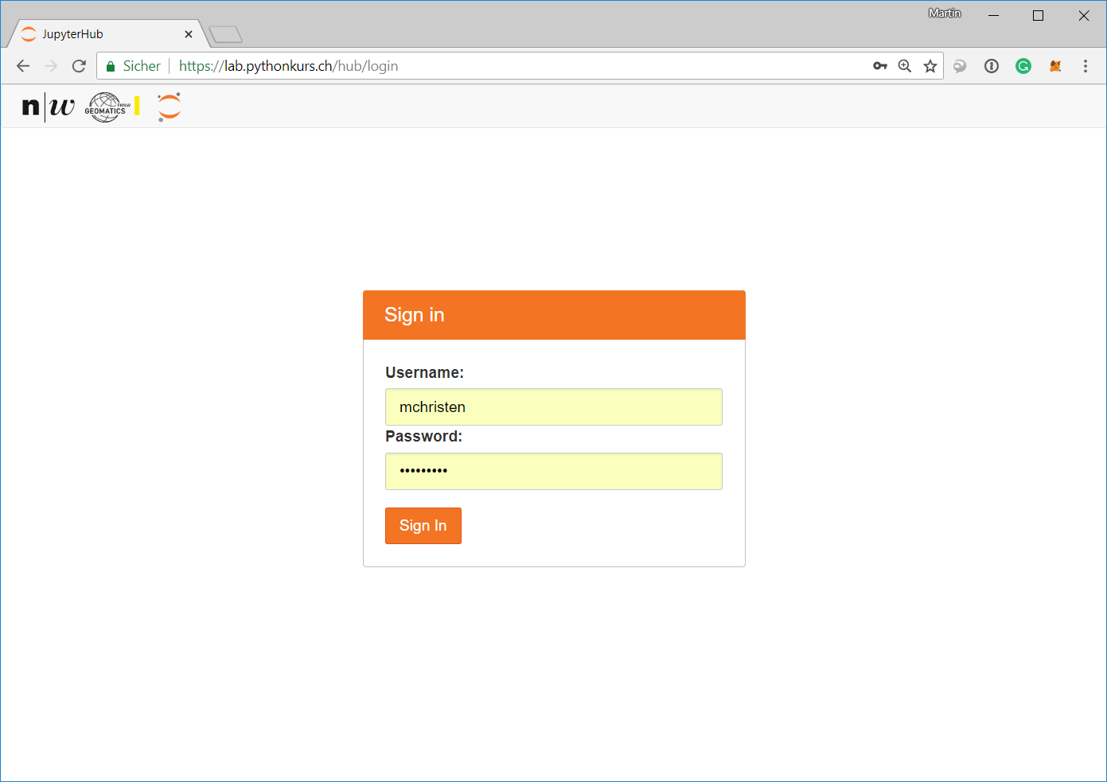
Login to JupyterHub

Slide 12
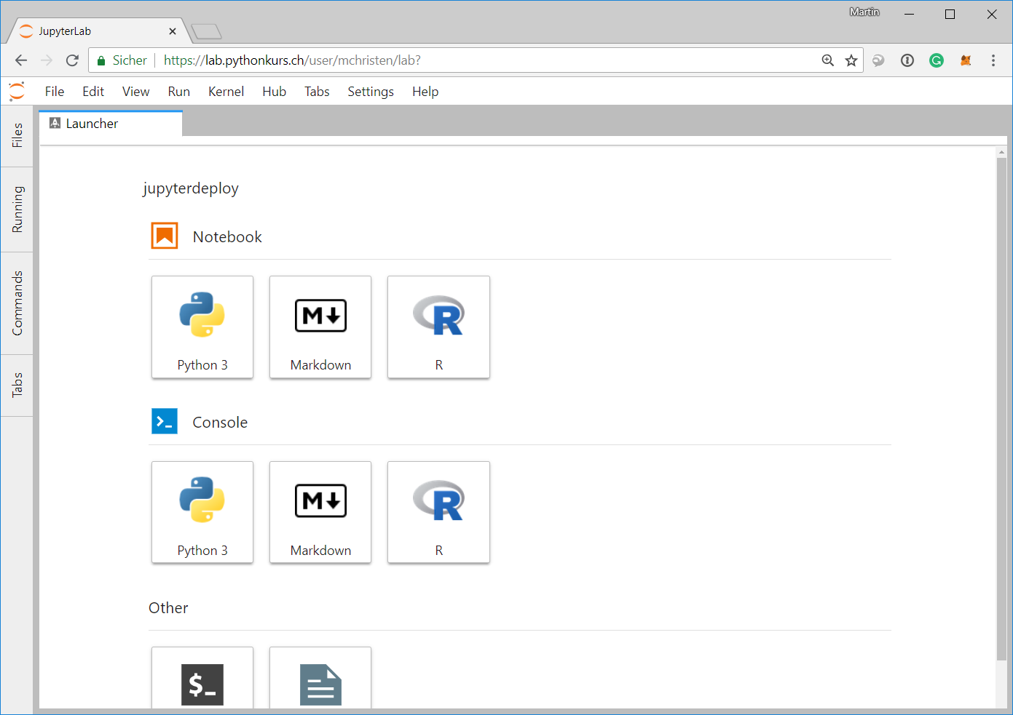
Starting Jupyter Lab for the user

Slide 13
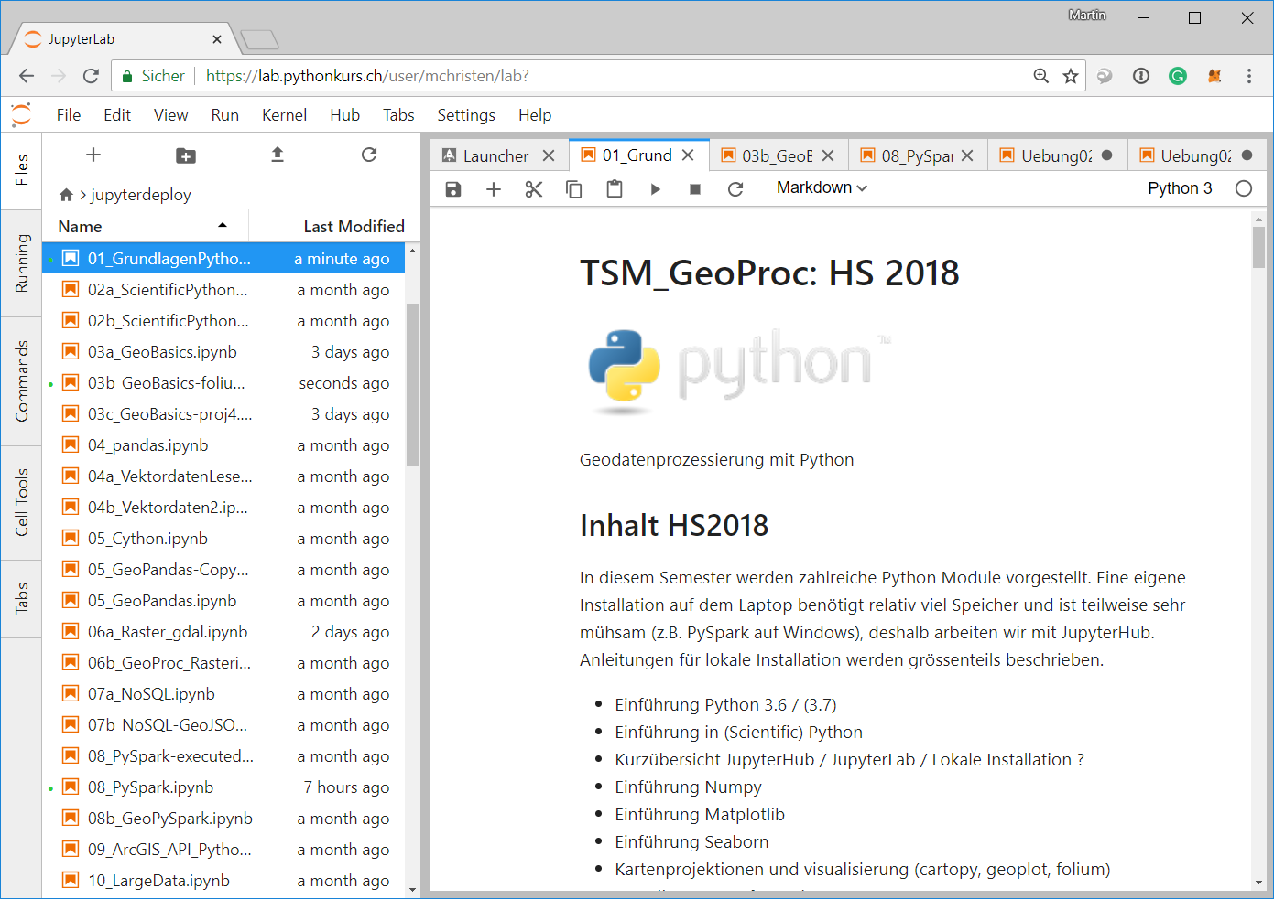
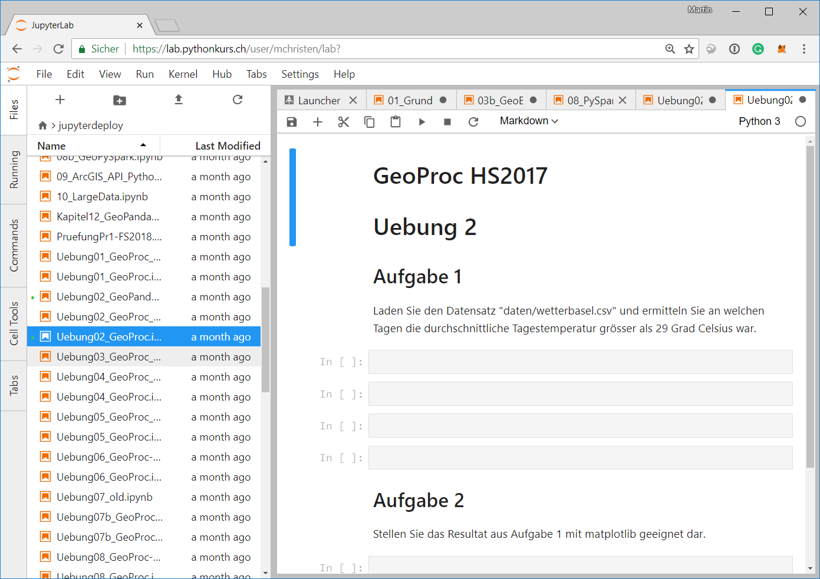
Login to JupyterHub

Slide 14
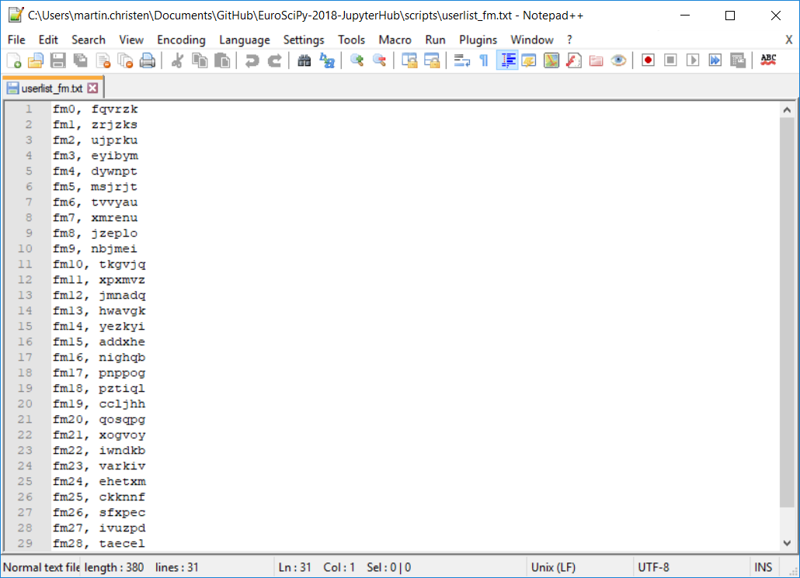
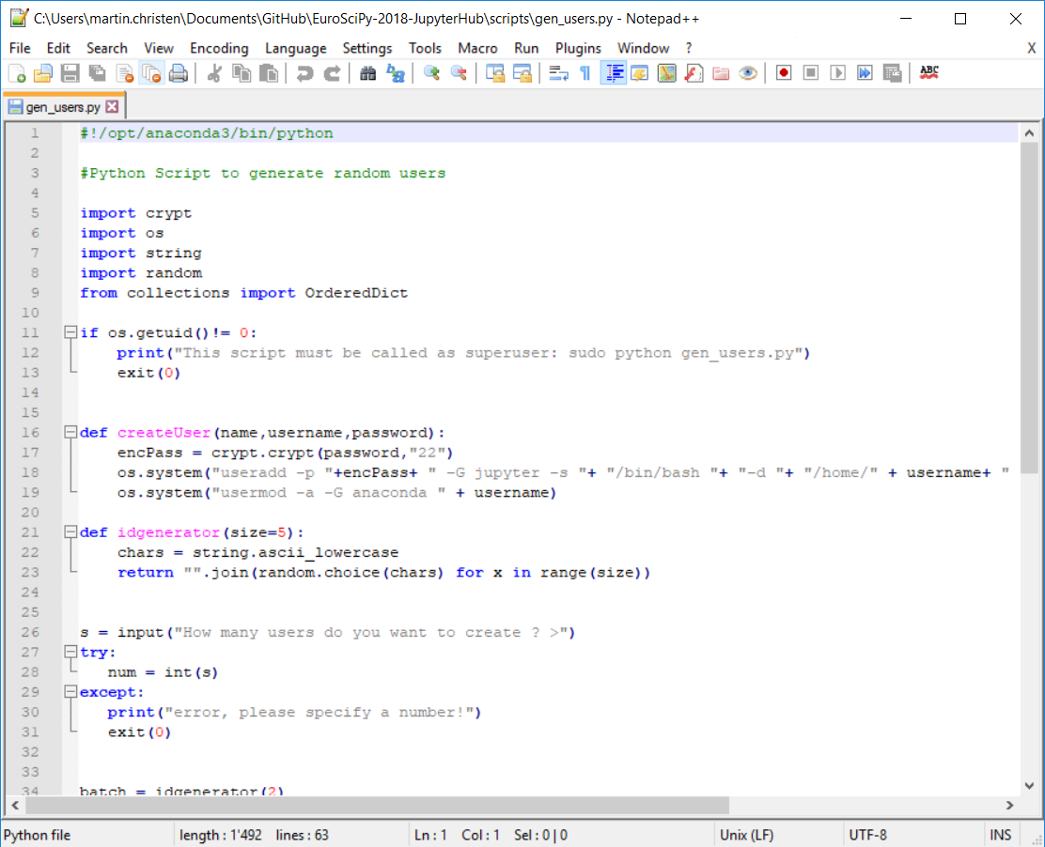
genusers.py - creating User/password for a specific course
Create Users and passwords

Slide 15
deploy_coursename.py
During the course:
Every week there is a new (or serveral new) Jupyter Notebooks available and an Exercise Notebook.
The notebooks are deployed to all students 72h before the next lesson
Also included is a general solution for the exercise
I created a simple deploy script which copies new files to all course members (using the course id created in genusers.py).
Also directories with all contents can be copied (for small datasets, pdf, …)

Slide 16
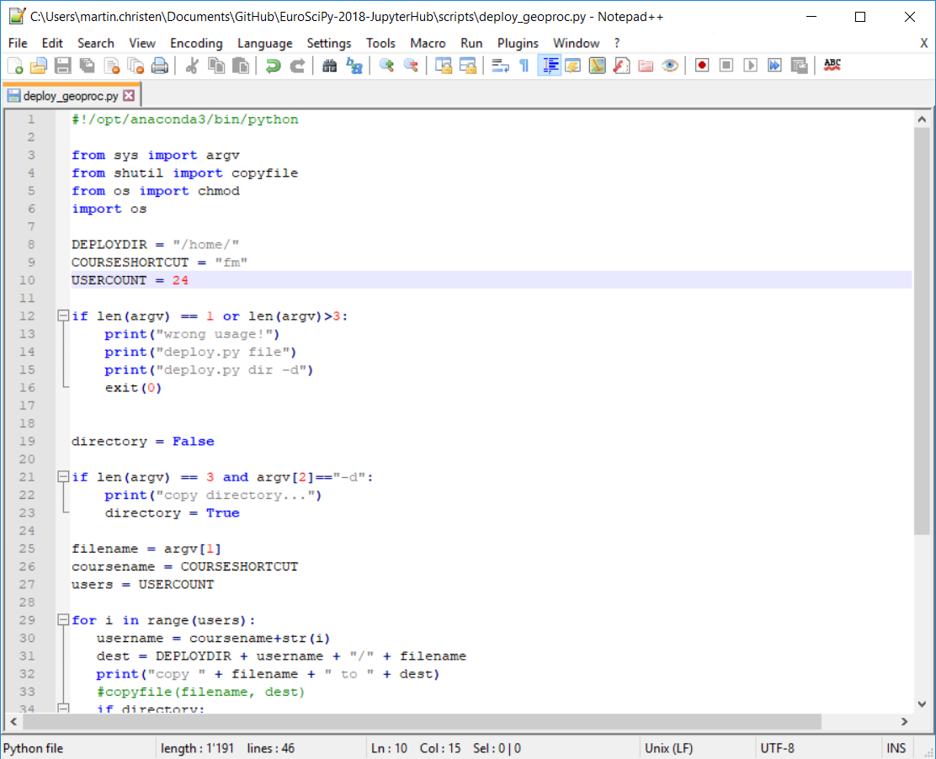
deploy_coursename.py

Slide 17
Large Data Files
Data is just located globally at /data/ and all users have read access.
This way multi TB datasets can be read by all without problems
Example: /data/landsat.tif
Previously I tried to use symbolic links but it didn’t really work well

Slide 18

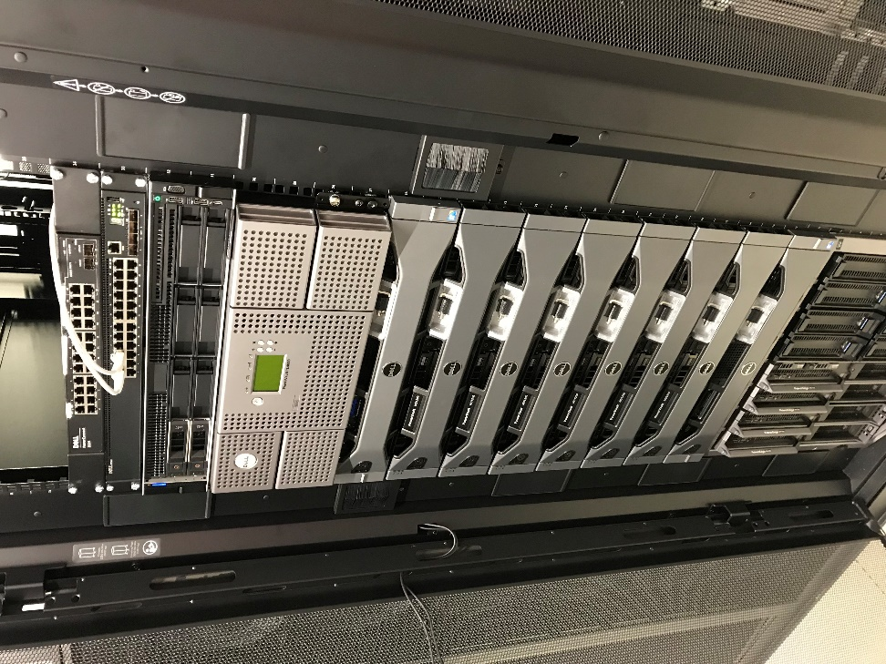

Cluster for JupyterHub
JuypterHub
124 CPU Cores 112 GB RAM 120 TB HD (~1 GB/s read/write)
currently only 4 GPUs, to be increased soon

Slide 19
Students feedback
«His teaching is clearly structured (central theme) and the subject matter was communicated in an understandable way.»
«Working with Jupyter(hub) was great and made everything much easier»
«Using Jupyterhub saved me much time»
«Programming using Jupyter(hub) was much fun. I wish other modules had
something similar»

Slide 20
Conclusion & Outlook
JupyterHub solves my major problems:
Doing exercises with really large datasets (1-10 TB)
No installation of modules / No time wasted in first lesson
Students don’t need space on their laptop for anaconda/modules/data (if they don’t want to install it locally)
I don’t have to write installation instructions for each OS / Python Version
GPUs can be used even if students don’t have a high-end graphics card.
Students like it
In future:
Add more GPUs (GPU cluster in 2nd Rack)
Also use JupyterHub for Research Projects

Slide 21


http://2019.geopython.net
Python in General
GIS/Mapping
Geography / Geophysics / Geodesy / Geomatics
Earth Sciences / Environmental Sciences
Geovisualization
Smart Cities
Spatial Data / Geodata
Geospatial Webservices
Big Data
Data Processing
(Spatial) Databases
Computer Vision
Remote Sensing
Image Processing
(Geo-)Machine Learning / (Geo-)Deep Learning
@GeoPythonConf

Slide 22
Questions
?

